Slide 1
Chapter 19
Application example Photo OCR
Problem description and pipeline
A machine learning application example or a machine learning key study centered around an application called photo OCR.
There are three reasons why I want to do this, first I want to show you an example of how a complex machine learning system can be put together.
Second, I want to talk about the concepts of a machine learning pipeline and how to allocate resources when you’re trying to decide what to do next. And this can be either in the context of your working by yourself on the big application. Or it can be the context of a team of developers trying to build a complex application together.
And then finally, the phot OCR problem also gives me an excuse to tell you about just a couple more interesting idea for machine learning. One is some ideas of how to apply machine learning to computer vision problems, and second is the idea of artificial data synthesis.

Slide 2
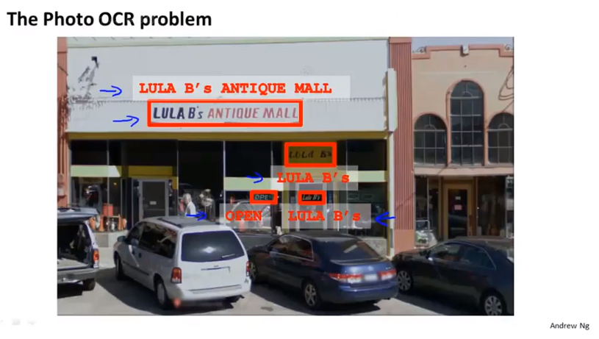
Chapter 19 OCR = optical character recognition

Slide 3
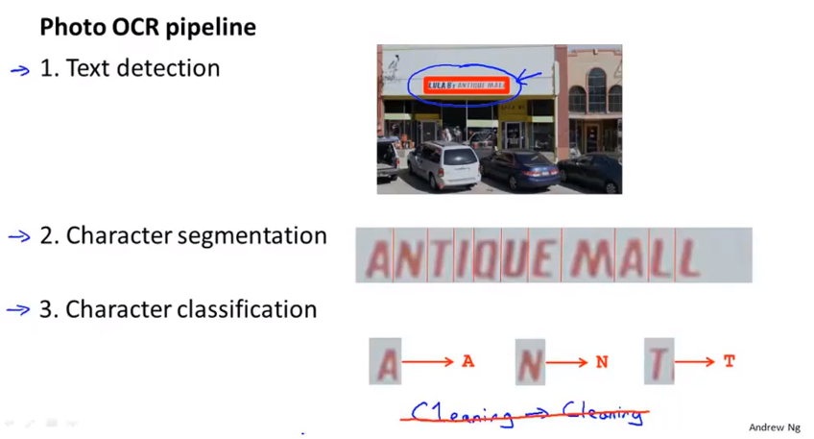
Chapter 19
A system like this will be called a machine learning pipeline

Slide 4
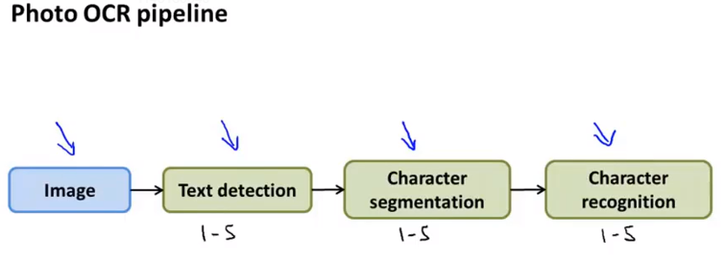
Chapter 19
In many complex machine learning systems, these sorts of pipelines are common, where you can have multiple modules. Each of them may be a machine learning component or sometimes it may not be a machine learning component, but to have a set of modules that act one after another on some piece of data in order to produce the output you want, which in the photo OCR example, is to find the transcription of the text that appeared in the image.
If you are designing a machine learning system, one of the most important decisions will often be exactly what is the pipeline that you want to put together. In other words, given the photo OCR problem, how do you break this problem down into a sequence of different modules and you design the pipeline, and the performance of each of the modules In your pipeline will often have a big impact on the final performance of your algorithm.
So having a pipeline like this often offers a natural way to divide up the workload among different numbers of an engineering team as well. Although, of course, all of this work could also be done by just one person if that’s how you want to do it

Slide 5
Chapter 19
Application example Photo OCR
Sliding windows

Slide 6
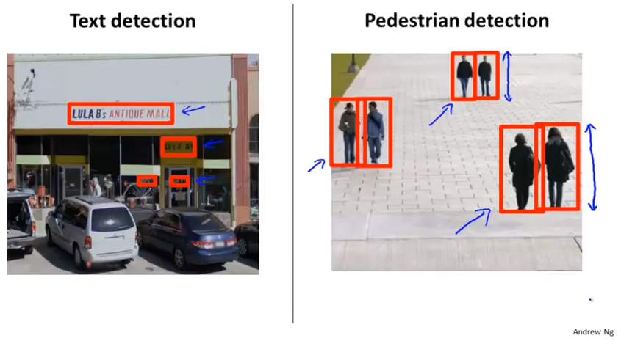
Chapter 19

Slide 7
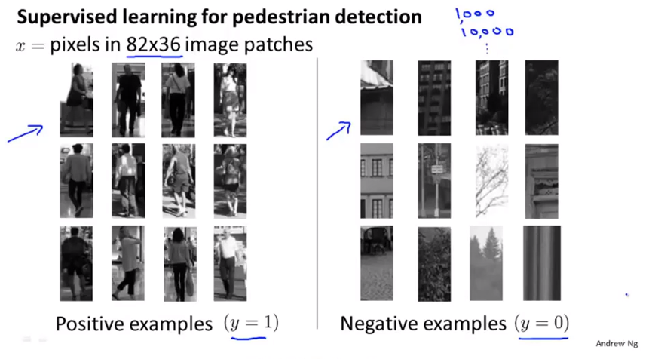
Chapter 19

Slide 8
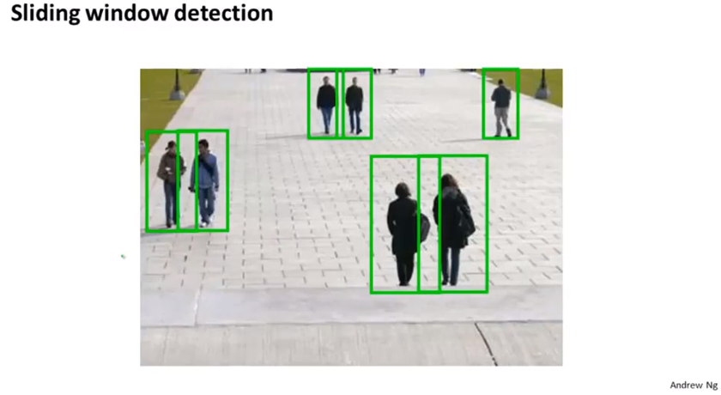
Chapter 19
Take a larger image patch, what I really means is when you take a image like this, what you’re really doing is taking that image patch and resizing it down to 82*36.

Slide 9
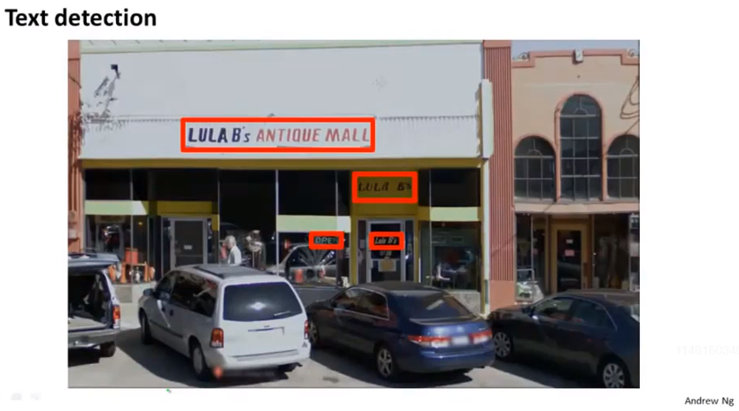
Chapter 19

Slide 10
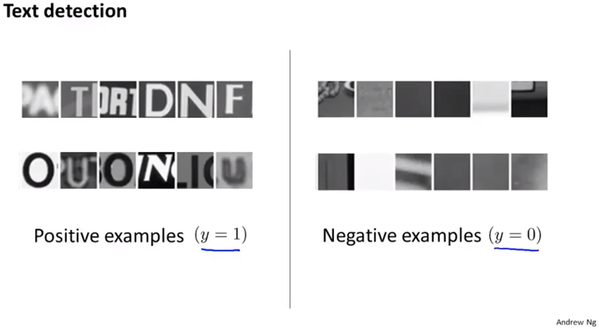
Chapter 19

Slide 11
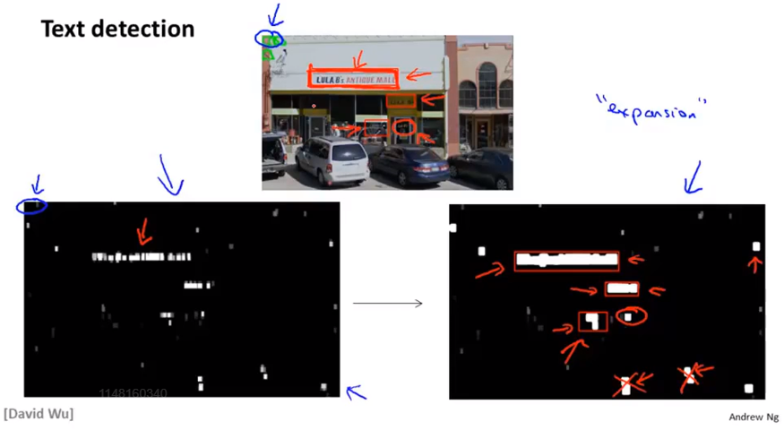
Chapter 19
In this particular example the classifier actually missed one piece of text. It’s very hard to read because there’s a piece of text written against a transparent window.

Slide 12
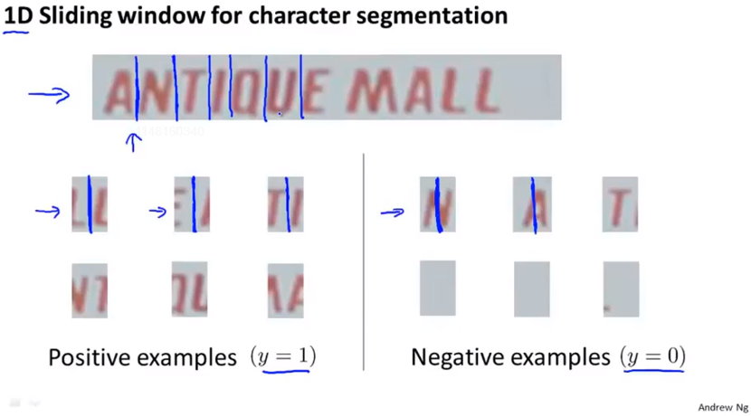
Chapter 19
1D we’re going to slide the window only in one straight line from left to right, there’s no different rows here

Slide 13
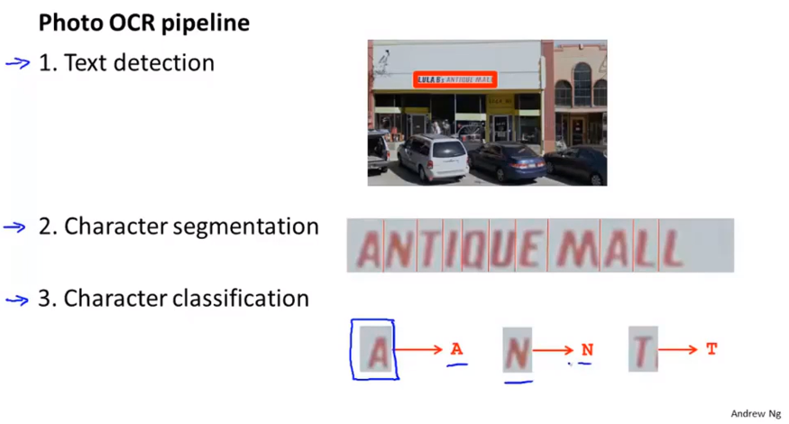
Chapter 19
But the multiclass classification problem where you take it’s input and image contained a character and decide what is the character that appears in that image.

Slide 14
Chapter 19
Application example Photo OCR
Getting lots of data: Artificial data synthesis
One of the most reliable ways to get a high performance machine learning system is to take a low bias learning algorithm and to train it on a massive training set.
Turns out that machine learning there’s a fascinating idea called artificial data synthesis, this doesn’t apply to every single problem, and to apply to a specific problem often takes some thought and innovation and insight. But if this idea applies to your machine learning problem it can sometimes be an easy way to get a huge training set to give to your learning algorithm.
The idea of artificial data synthesis comprises of two main variations, The first is if we are essentially creating data from whole cloth. So it is creating new data from scratch. And second is if we already have a small label training set and we somehow have amplify that training set or use a small training set to turn that into a large training set.

Slide 15
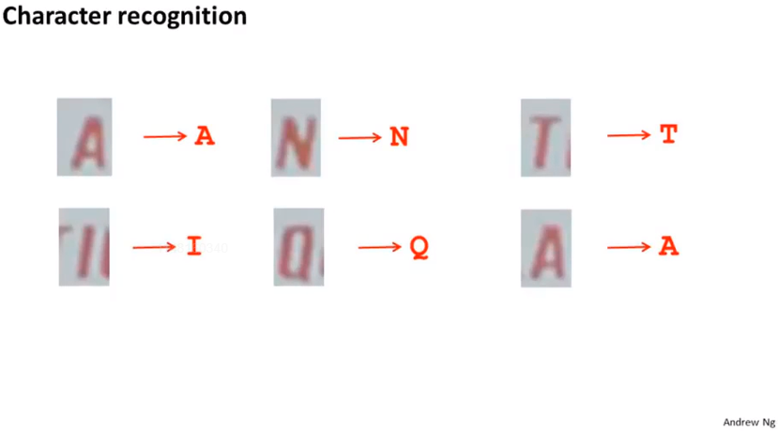
Chapter 19

Slide 16
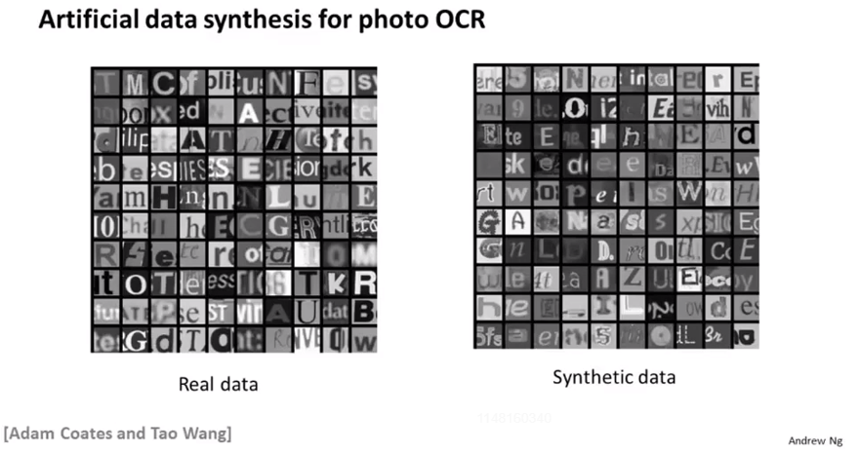
Chapter 19
Colored images do not help too much.
Creating new data from scratch, you just generating brand new images form scratch

Slide 17
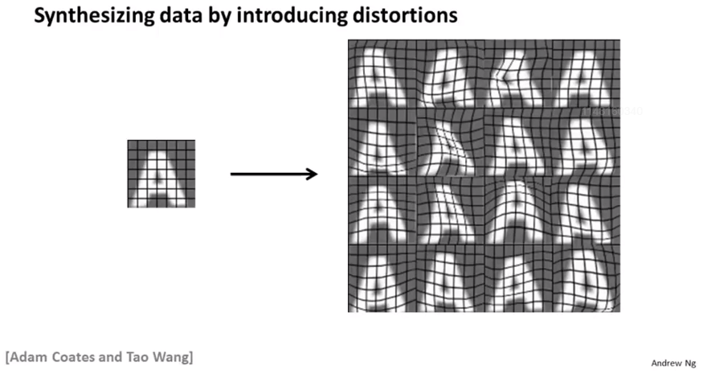
Chapter 19
Take examples that you currently have, so we take a real example, maybe from real image and you create additional data so as to amplify your training set.
Introduce artificial warpings or artificial distortions into the image

Slide 18
Chapter 19
Again, in order to do this for particular application. It does take thought and it does take insight to figure out what are the reasonable sets of distortions, or what are these ways that amplify and multiple your training set, and for the specific example of character recognition introduce these warping seems like a natural choice, but for a different machine learning application, there maybe different distortions that might make more sense.

Slide 19
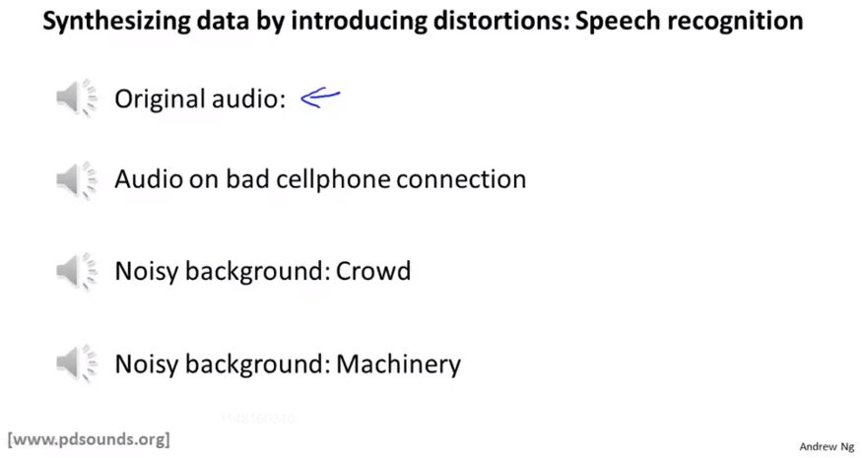
Chapter 19
Automatically adding these different background sounds to the clean audio clip.

Slide 20
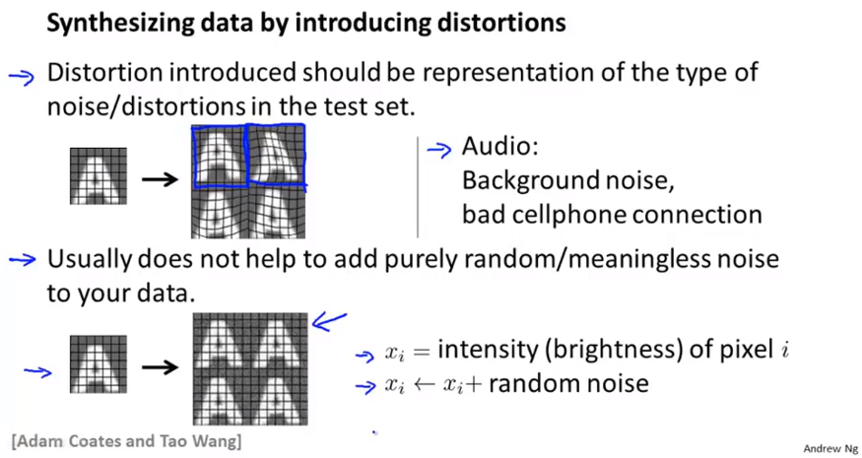
Chapter 19
But the process of artificial data synthesis, it is a little bit of art as well and sometimes you just have to try it and see if it works. But if you’re trying to decide what sorts of distortions to add do think about what are the meaningful distortions you might add that will cause you to generate additional training examples that are at least somewhat representative of the sorts of images you expect to see in your test sets.

Slide 21
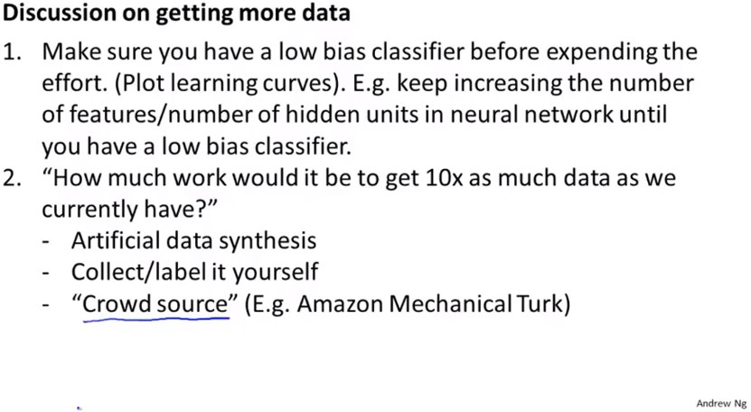
Chapter 19 this can be a great way to get much better performance
Crowd source: 众包

Slide 22
Chapter 19
Artificial data synthesis:
Creating new date from scratch, like using the random fonts as an example or by amplifying an existing training set by taking existing label examples and introducing distortions to create extra label examples.
If you are facing a machine learning problem, it is often worth doing two things.
One is just a sanity check, with learning curves that having more data would help.
And second, assuming that that’s the case, I will often sit down and ask self seriously what it would take to get ten times as much training data as you currently have, and not always but sometimes, you maybe surprised by how easy that turns out to be, maybe a few days, a few weeks at work and that could be a great way to give you learning algorithm a huge boost in performance.

Slide 23
Chapter 19
Application example Photo OCR
Ceiling analysis: What part of the pipeline to work on next.
Ceiling analysis.
When you and your team are working on a pipeline machine learning system, this can sometimes gives a very strong signal, a very strong guidance on what parts of the pipeline might be the best use of your time to work on.

Slide 24
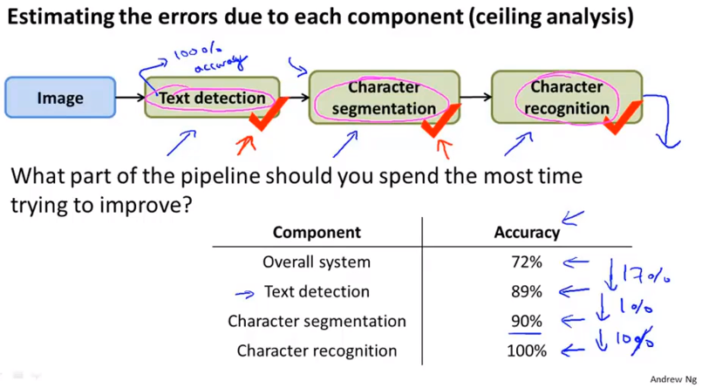
Chapter 19

Slide 25
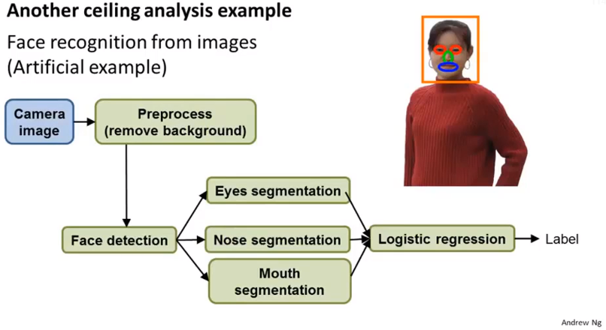
Chapter 19

Slide 26
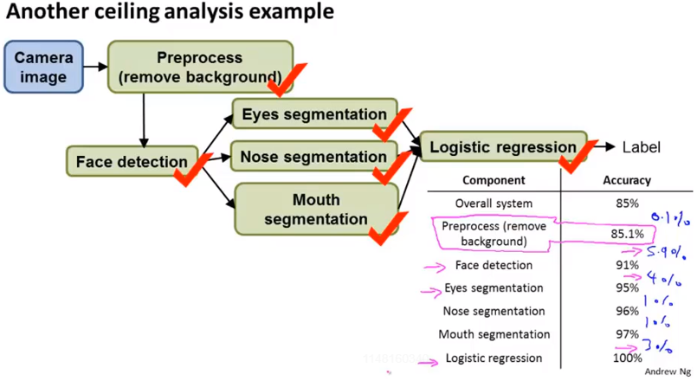
Chapter 19
This tell us maybe one of the components that are most worth our while working on.

Slide 27
Chapter 19
So to summarize, pipelines are pretty pervasive and complex machine learning application. And when you are working on a big machine learning application, I mean I think your time as a developer is so valuable. So just don’t waste your time working on something that ultimately isn’t going to matter.
Ceiling analysis, which I’ve often found to be a very good tool for identifying the component that if you actually put a focused effort on that component and make a big difference, it would actually have a huge effect on the overall performance of your final system.
To do a ceiling analysis often does a much better and much more reliable way for deciding where to put a focused effort into, to really improve the performance of some component. And we kind of be sure that when you do that it will have a huge effect on final performance of your system.

